Slide 1
ILLINOIS JUDICIAL BRANCH
PUBLIC RELATIONS PLAN
PRETRIAL IMPLEMENTATION TASK FORCE
DRAFTED BY THE ILLIONIS JUDICIAL CONFERENCE
PUBLIC RELATIONS TASK FORCE
Town Hall|Thursday, July 21
JUNE 2022

Slide 2
Please submit questions via the Zoom chat or email to pretrialtaskforce@illinoiscourts.gov
Housekeeping
Please keep yourself muted to limit background noise. This session is being recorded and will be posted on the website.
Anyone disrupting the Town Hall will be removed.

Slide 3
Welcome
Introduction
Hon. Robbin Stuckert, Chair, Illinois Supreme Court Pretrial Implementation Task Force
Judge Stuckert is the Chair of the Illinois Supreme Court Pretrial Implementation Task Force after previously leading the Supreme Court Commission on Pretrial Practices. She served as a trial court judge for 20 years and retired from the bench in 2021.

Slide 4
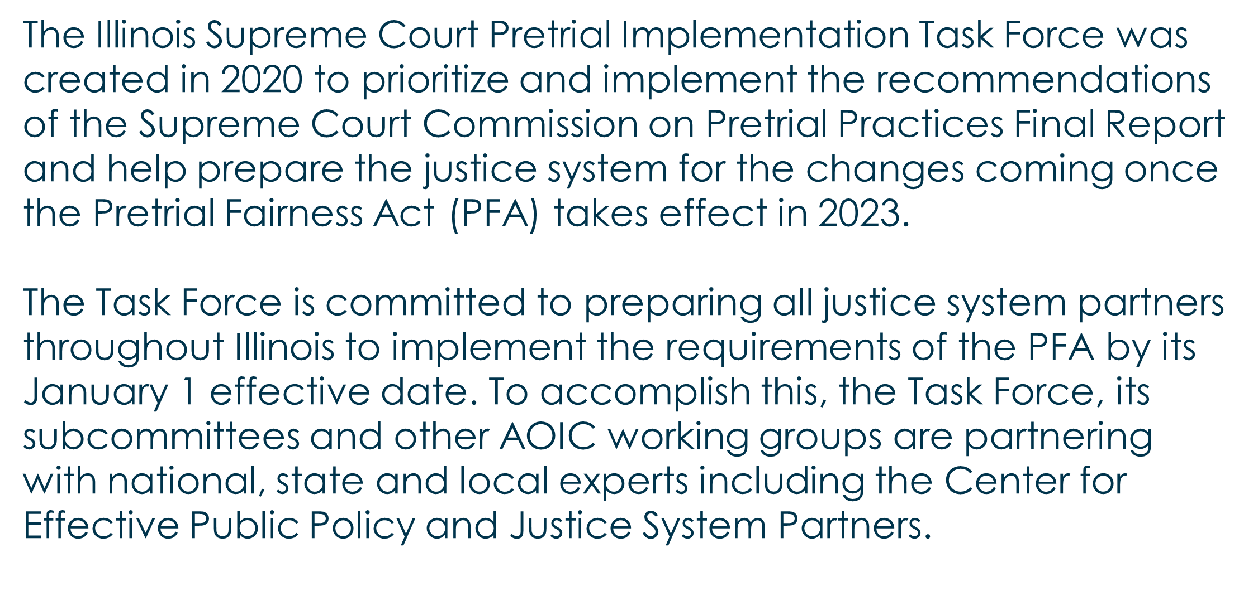
Role of the task force
Pretrial Implementation Task Force

Slide 5
Topics for Today’s Town Hall
Release by Citation
Release from Custody
Presenters:
Chief Judge Clint Hull, 16th Circuit
Keith Grant, President, Public Defender’s Association

Slide 6
109-1(a-1): “Law enforcement shall issue a citation in lieu of custodial arrest, upon proper identification, for those accused of traffic and Class B and C criminal misdemeanor offenses, or of petty and business offenses, who pose no obvious threat to the community or any person, or who have no obvious medical or mental health issues that pose a risk to their own safety. Those released on citation shall be scheduled into court within 21 days.”
Release by Citation – 725 ILCS 5, 109-1(a-1)

Slide 7
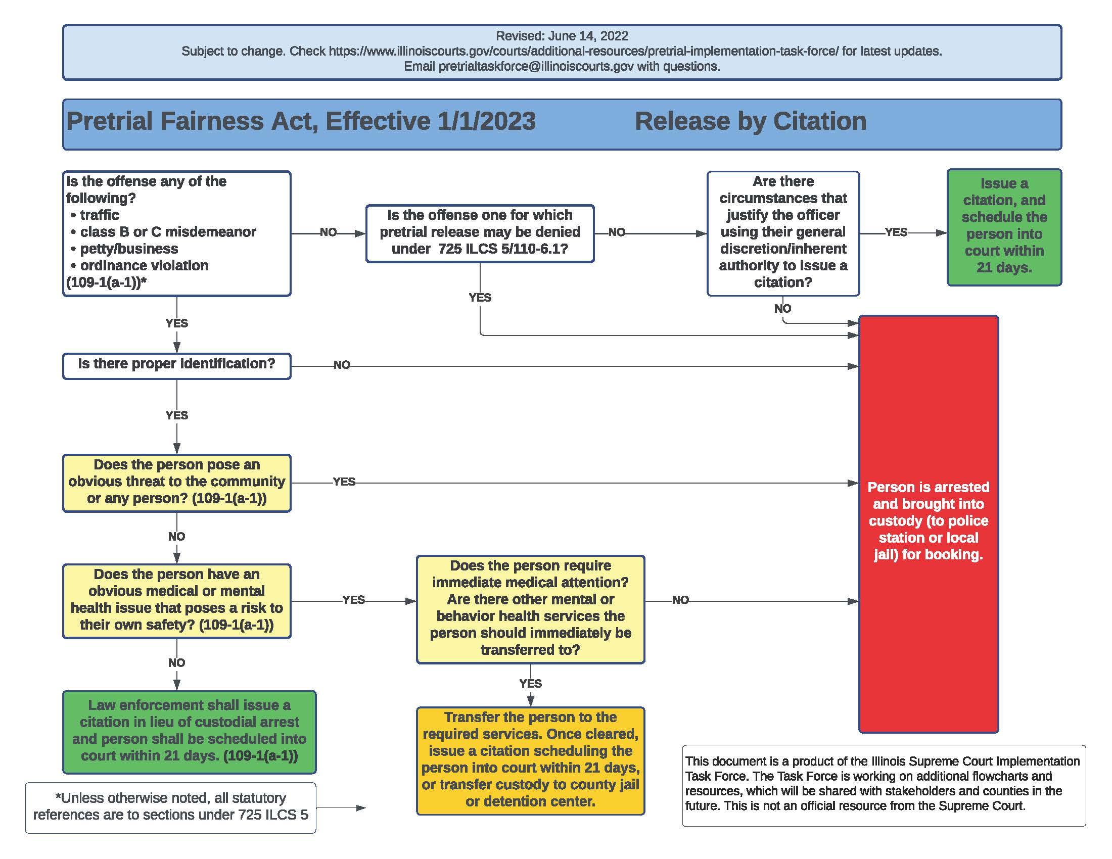
Release by Citation: Flowchart
Notes:
Click to show map

Slide 8
What is the Change?
Law enforcement is instructed to cite and release for certain offenses under certain circumstances.
The law tries to identify the situations that are the safest to cite and release.

Slide 9
Class M
Class X
Class 1
Class 2
Class 3
Class 4
Class A Misdemeanors
Class B, C Misdemeanors
Traffic
Petty Offenses
Ordinances

Slide 10
Why Make This Change?
Pretrial detention of any length of time is harmful
It can disrupt a person’s employment and family ties
Research demonstrates that people detained pretrial are more likely to have worse outcomes
Data shows that the destabilization resulting from even short detention actually increases a person’s risk of recidivism
Fewer people being held in jail reduces an unnecessary cost to the system
Fewer people being processed into jail frees up law enforcement to remain on the street

Slide 11
Operational Challenges
Statute does not define:
“proper identification”
“obvious threat”
“obvious medical or mental health issues”
Law enforcement organizations need to create guidance to ensure consistent application
Law enforcement must consider how best to refer people to treatment
Law enforcement must coordinate with Clerk’s Office on court dates and forms

Slide 12
Release from Custody – 725 ILCS 5, 109-1(a-3)
109-1(a-3) “A person arrested with or without a warrant for an offense for which pretrial release may not be denied may, except as otherwise provided in this Code, be released by the officer without appearing before a judge. The releasing officer shall issue the person a summons to appear within 21 days. A presumption in favor of pretrial release shall be applied by an arresting officer in the exercise of his or her discretion under this Section.”

Slide 13
Release from Custody – Flowchart

Slide 14
What is the Change?
Establishes presumption of release from custody for offenses that are not eligible for pretrial detention
Defines rights while in custody to allow for greater access to phone calls and communications with people while in custody

Slide 15
Why Make This Change?
To allow for people to communicate with loved ones and others when placed into custody (arrange transport, inform family members, inform work, communicate with counsel, etc.)
To minimize time in custody in order to reduce risk of destabilization and attendant risk to public safety
To reduce unnecessary system cost

Slide 16
Operational Challenges
Similar concerns as cite and release:
Law enforcement organizations need to create guidance to ensure consistent application of the law
There will need to be established ways for referring people to treatment
Law enforcement and the Clerk’s Office will need to strengthen coordination
Law enforcement concerned about interpretation of right to communicate
When is someone in ”custody”?
How do you protect the person’s privacy when making calls?
If person transported, do they receive another set of calls?

Slide 17
The Task Force will publish the work of the Guidelines Subcommittee on an ongoing basis ahead of the Jan. 1 effective date: • Citations/release from police custody • First appearance • Conditions of release • Detention hearings • Modification of conditions/Revocation
Releasing Guidance on the PFA
Notes:
Click to show map

Slide 18
Questions?
Website: www.illinoiscourts.gov/courts/additional-resources/pretrial-implementation-task-force/
Email: pretrialtaskforce@illinoiscourts.gov

Slide 19
Upcoming Town Halls
August 18, Noon
September 15, Noon
October 20, Noon
All meetings will be held via Zoom unless otherwise noted.

